Slide 1

Investigating geopolymer-mediated adsorption of MRSA cells and secreted proteins
Collin Ganser
Dr. Shelley E. Haydel – The Biodesign Institute Center for Immunotherapy, Vaccines and Virotherapy
Shaojiang Chen and Dr. Dong-Kyun Seo – The Biodesign Institute Center for Molecular Design and Biomimetics
4-13-19
Arizona NASA Space Grant Statewide Symposium

Slide 2
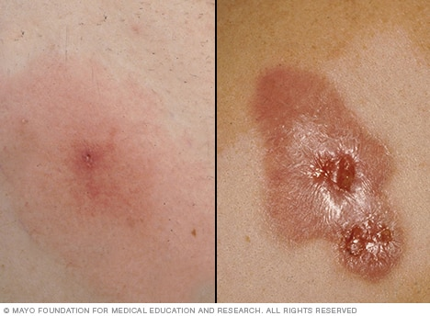
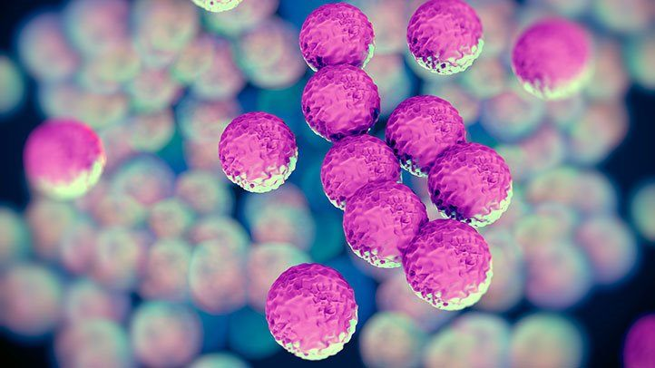
MRSA
Methicillin-resistant Staphylococcus aureus
Major cause of skin and soft tissue infections
Difficult to treat due to antibiotic resistance
Fritz, A. L., & Jasmer, R. (2018). Everything You Need to Know About the Superbug, MRSA | Everyday Health.

Slide 3
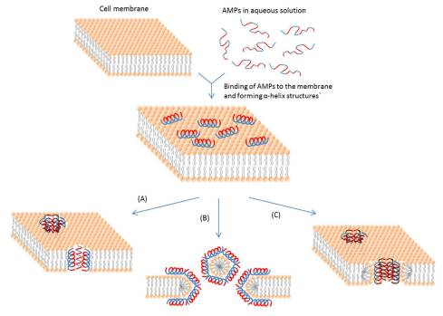
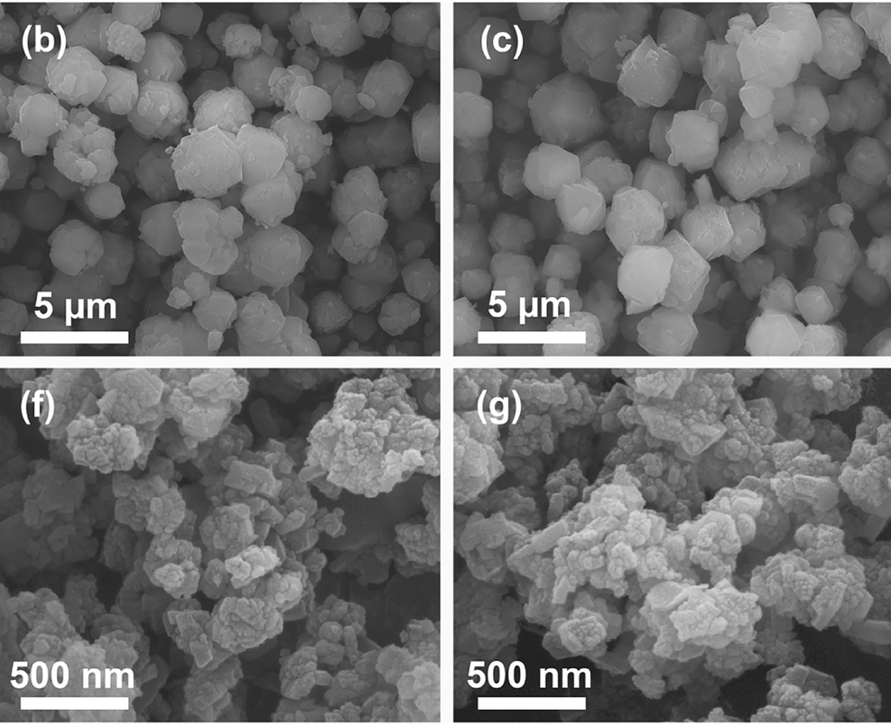
Alternative Treatment Methods
Antimicrobial peptides
Metal ions
  Microzeolites
  Nanozeolites
Bahar, A. A., & Ren, D. (2013). Antimicrobial Peptides. Pharmaceuticals,6(12), 1543-1575.

Slide 4
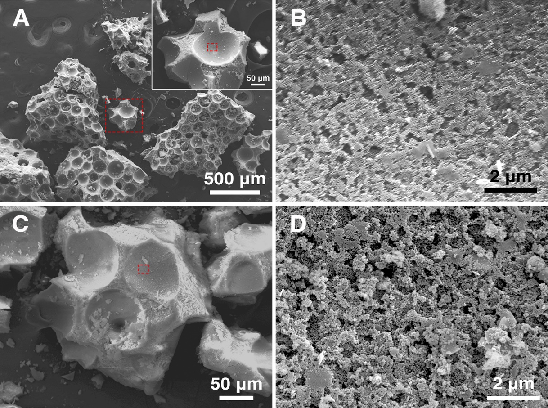
Geopolymers
Aluminosilicate materials
Contain cage-like structures that act as pores
Can alter pore size
  macro vs. meso
Can alter surface chemistry
  non-coated vs. stearic acid-coated

Slide 5
Methodology
Tested geopolymers adsorption capability of whole cells and secreted proteins (culture filtrate proteins [CFP])
Basic idea: isolate adsorption target and incubate with geopolymers

Slide 6

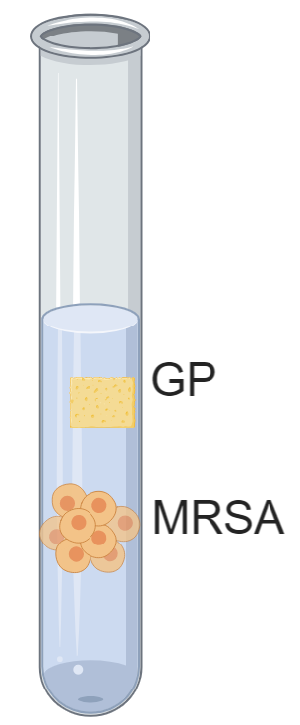
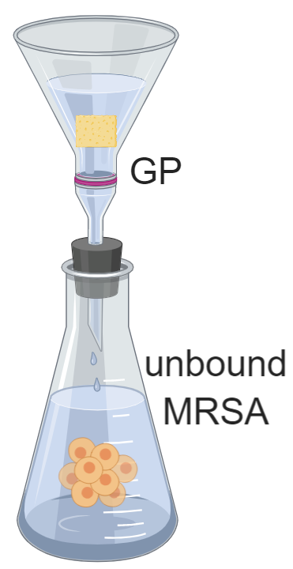

MRSA Whole Cell Adsorption
Grew MRSA in tryptic soy broth and resuspended in saline
Incubated MRSA cells with 10, 5, and 0 mg/mL GP for 1 h
Separated unbound MRSA from GP with filter
Plated unbound MRSA to quantify GP adsorption

Slide 7
Whole Cell Adsorption Results

Slide 8
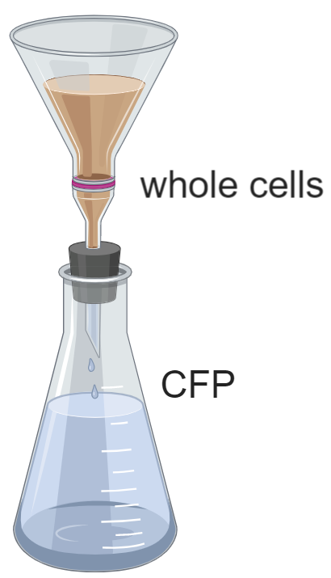
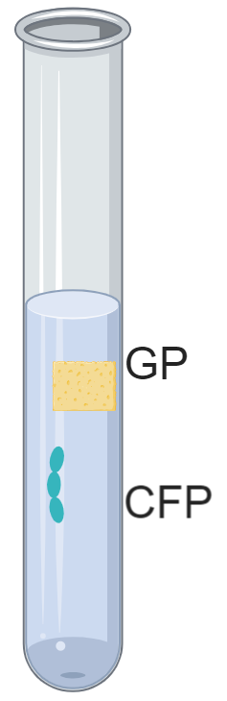

Secreted MRSA Protein Adsorption
Grew MRSA in chemically defined medium to generate CFP
Separated CFP from MRSA to remove whole cells
Incubated CFP with GP for 1 h to test adsorption capabilities
Resolved on SDS-PAGE to compare CFP incubated with and without GP

Slide 9
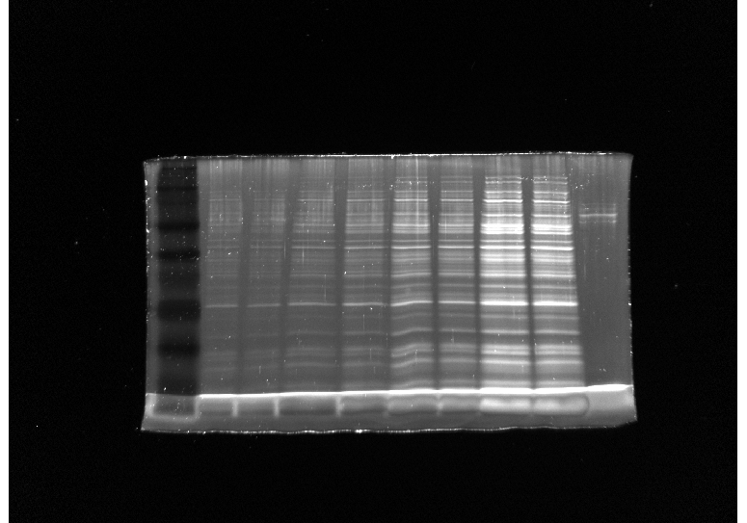
Secreted Protein Adsorption Results
L
2.7
6.8
13.6
27
CDM
μg/mL CFP
GP
- +
- +
- +
- +

Slide 10
Conclusions
Geopolymers’ ability to adsorb whole MRSA cells:
  macroGP > SA-macroGP > SA-mesoGP > mesoGP
SA-macroGP (1 mg/mL) does not adsorb MRSA CFP (2.7-27μg/mL)

Slide 11
Future Directions
Compare different concentrations and types of GP for CFP adsorption
If GP adsorbs MRSA CFP, perform mass spectrometry to identify adsorbed proteins

Slide 12
Acknowledgements
Dr. Shelley E. Haydel
John Popovich
Michelle McBride
Shaojiang Chen
Dr. Dong-Kyun Seo
ASU/NASA Space Grant
School of Life Sciences Undergraduate Research (SOLUR) Program

Slide 13
Thank You!
Questions?

